Slide 1
Structural Diagrams

Slide 2
3 basic building blocks of UML - Diagrams
Graphical representation of a set of elements.
Represented by a connected graph: Vertices are things; Arcs are relationships/behaviors.
5 most common views built from
UML 1.x: 9 diagram types.
UML 2.0: 12 diagram types
Structural Diagrams
Represent the static aspects of a system.
  Class;
  Object
  Component
  Deployment
Structural Diagrams
  Class;
  Object
  Component
  Deployment
  Composite Structure
  Package
Behavioral Diagrams
Represent the dynamic aspects.
  Use case
  Sequence;
  Collaboration
  Statechart
  Activity
Behavioral Diagrams
  Use case
  Statechart
  Activity
Interaction Diagrams
  Sequence;
  Communication
  Interaction Overview
  Timing

Slide 3
Class Diagram
The basis for all object modeling
All things lead to this
Most common diagram.
Shows a set of classes, interfaces, and collaborations and their relationships (dependency, generalization, association and realization); notes too.
Represents the static view of a system (With active classes, static process view)
Three modeling perspectives for Class Diagram
Conceptual: the diagram reflects the domain
Specification: focus on interfaces of the software (Java supports interfaces)
Implementation: class (logical database schema) definition to be implemented in code and database.
Most users of OO methods take an implementation perspective, which is a shame because the other perspectives are often more useful. -- Martin Fowler

Slide 4
Names
Classes
type/class
Account
simple name - start w. upper case
balance: Real = 0
default value
Attributes
<<constructor>>
+addAccount()
<<process>>
+setBalance( a : Account)
+getBalance(a: Account): Amount
…
<<query>>
isValid( loginID : String): Boolean
short noun - start w. lower case
Operations
signature
may cause object to
change state
ellipsis for additional
attributes or operations
stereotypes to categorize
Bank
Customer
only the name compartment, ok
Java::awt::Polygon
path name = package name ::package name::name

Slide 5
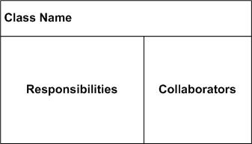
Responsibilities
Account
Responsibilities
-- handles deposits
-- reports fraud to managers
anything that a class knows or does
(Contract or obligation)
An optional 4th item carried out by attributes and operations.
Free-form text; one phrase per responsibility.
Technique - CRC cards (Class-Responsibility-Collaborator); Kent Beck and Ward Cunningham’89
A collaborator is also a class which the (current) class interacts with to fulfill a responsibility
Customer
Account
Opens account
Knows name
Knows address
Account
Knows interest rate
Knows balance
Handles deposits
Reports fraud to
manager
Manager

Slide 6
Scope & Visibility
Instance Scope — each instance of the classifier holds its own value.
Class Scope — one value is held for all instances of the classifier (underlined).
Instance scope
Frame
class scope
header : FrameHeader
uniqueID : Long
public
+ addMessage( m : Message ) : Status
Public
class
Public
method
Public
attribute
# setCheckSum()
protected
- encrypt()
- getClassName()
Private
class
private
Protected
class
Public - access allowed for any outside classifier (+).
Protected - access allowed for any descendant of the classifier (#).
Private - access restricted to the classifier itself (-).
(using adornments in JBuilder)

Slide 7
Multiplicity
singleton
multiplicity
NetworkController
1
3
consolePort [ 2..* ] : Port
ControlRod
Using Design Pattern
Singleton
public class Singleton {
private static Singleton instance = null;
private Singleton() {}
public static Singleton getInstance() {
if (instance == null) {
instance = new Singleton();
}
return instance;
}
}
- instance
+ getInstance():Singleton
NetworkController
consolePort [ 2..* ] : Port
Notes:
Empty compartment
Stereotypes

Slide 8
Relationships
Window
Event
open()
close()
dependency
generalization
association
ConsoleWindow
DialogBox
Control
Controller
EmbeddedAgent
generalization
(multiple inheritance)
<<interface>>
URLStreamHandler
association navigation
SetTopController
authorizationLevel
PowerManager
openConnection()
parseURL()
setURL()
toExternalForm()
startUp()
shutDown()
Connect()
<<friend>>
ChannelIterator
realization
stereotyped dependency

Slide 9
Dependency
A change in one thing may affect another.
The most common dependency between two classes is one where one class <<use>>s another as a parameter to an operation.
AudioClip
name
Microphone
record(m:Microphone)
start()
stop()
dependency
Using relationship
CourseSchedule
addCourse(c : Course)
removeCourse(c : Course
Course
Usually initial class diagrams will not have any significant number of dependencies in the beginning of analysis but will as more details are identified.

Slide 10
Dependency – Among Classes
AbstractClass {abstract}
<<metaclass>>
<<interface>>
attribute
MetaClassName
InterfaceName
concreteOperation()
abstractOperation()
operation()
<<instanceOf>>
generalization
realization
ClassName
-simpleAttribute: Type = Default
#classAttribute: Type
+/derivedAttribute: Type
<<use>>
+operation(in arg: Type = Default): ReturnType
<<instanceOf>>
objectName: ClassName
ClientClass
Attribute = value
simpleAttribute: Type = Default
classAttribute: Type
/derivedAttribute: Type

Slide 11
Dependency –Among Classes
Eight Stereotypes of Dependency Among Classes
  bind: the source instantiates the target template using the given actual parameters
  derive: the source may be computed from the target
  friend: the source is given special visibility into the target
  instanceOf : the source object is an instance of the target classifier
  instantiate: the source creates instances of the target
  powertype: the target is a powertype of the source; a powertype is a classifier whose objects are all the children of a given parent
  refine: the source is at a finer degree of abstraction than the target
  use: the semantics of the source element depends on the semantics of the public part of the target

Slide 12
Dependency –Among Use Cases
Two Stereotypes of Dependency Among Use Cases:
  extend: the target use case extends the behavior of the source
  include: the source use case explicitly incorporates the behavior of another use case at a location specified by the source
System
Use Case A
Actor
<<include>>
<<extend>>
Order Processing System
Place Order
<<actor>>
Actor
Use Case B
Use Case C
Extension points
Additional requests:
after creation of
the order
<<extend>>
Request Catalog
1
*
The sales person
asks for the catalog
SalesPerson
<<include>>
<<include>>
<<include>>
Supply Customer Info.
Order Item
Make Payment

Slide 13
Generalization
Four Standard Constraints
  complete: all children in the generalization have been specified; no more children are permitted
  incomplete: not all children have been specified; additional children are permitted
  disjoint: objects of the parent have no more than one of the children as a type
  overlapping: objects of the parent may have more than one of the children as a type
One Stereotype
  implementation: the child inherits the implementation of the parent but does not make public nor support its interfaces

Slide 14
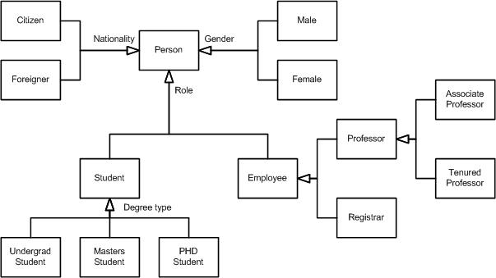
Generalization – Along Roles

Slide 15
Generalization –Among Actors
Place Order
Extension points
Additional requests:
after creation of the order
1
*
SalesPerson
Sales person can do only “Place Order”;
Sales manager can do both “Place Order”
and “Grant Credit”
Grant Credit
1
*
SalesManager

Slide 16
Associations
Represent conceptual relationships between classes
(cf. dependency with no communication/message passing)
direction indicator:
how to read relation name
navigability
relationship name
Professor
teaches
Course
*
1..*
teacher
class
role names
Multiplicity
defines the number of objects associated with an instance of the association.
  Default of 1;
  Zero or more (*);
  n..m; range from n to m inclusive
{visibility} {/} role name {: interface name}

Slide 17
Associations – A Question
How would you model the following situation?
“You have two files, say homework1 and myPet, where homework1 is read-accessible only by you, but myPet is write-accessible by anybody.”
You could create two classes, File and User.
Homework1 and MyPet are files, and you are a user.
File
User
<<instanceOf>>
<<instanceOf>>
homework1:File
u:User
myPet:File
anyoneElse: User
Approach 1: Now, would you associate the file access right with File?
Approach 2: Or, would you associate the file access right with User?

Slide 18
Associations – Links
  link is a semantic connection among objects.
  A link is an instance of an association.
association
class
class
association name
Worker
+setSalary( s : Salary)
+setDept( d : Dept)
1..*
works for
*
Company
employee
employer
?
<<instanceOf>>
<<instanceOf>>
w : Worker
assign(development)
: Company
link
named object
anonymous object
Association generalization is not automatic, but should be explicit in UML

Slide 19
Associations – Link Attributes
Link Attributes
The most compelling reason for having link attributes is for-many-to-many relationships
File
User
link attribute
access permission
Association Class
File
*
1..*
User
visual tie
AccessRight
access permission
association class
With a refactoring
1
1..*
AccessRight
*
1
File
User
access permission

Slide 20
Modeling Structural Relationships
Considering a bunch of classes and their association relationships
1
0..1
School
has
Department
1..*
1..*
1..*
1..*


assigned to
member
*
1..*
1..*
1
chairperson

*

1..*
Student
attends
Course
teaches
Instructor
*
*
The model above is from Rational Rose. How did the composite symbol ( )get loaded versus the aggregation? Use the Role Detail and select aggregation and then the “by value” radio button.

Slide 21

Modeling Structural Relationships
Aggregation
- structural association representing “whole/part” relationship.
“has-a” relationship.
multiplicity
whole
part
1..*
Company
Department
association
aggregation
Composite
Composite is a stronger form of aggregation.
Composite parts live and die with the whole.
Composite parts may belong to only one composite.
Car
Body
Part -> whole?
Body
Liver
Heart
Liver
Heart
Wheel
Engine
Can aggregations of objects be cyclic?

Slide 22
Association – Qualification
Bank
Qualifier,
cannot access person without knowing the account #
account #
*
0..1
Person
Chessboard
rank:Rank
file:File
1
1
Square
*
0..1
WorkDesk
jobId : int
returnedItem

Slide 23
Association – Interface Specifier
association
worker : IEmployee
*
Person
1
supervisor : IManager
Interface Specifier
Realization
A semantic relationship between classifiers in which one classifier specifies a contract that another guarantees to carry out.
In the context of interfaces and collaborations
An interface can be realized by many classes/components
A class/component may realize many interfaces
IManager
Person
getProject()
getSchedule()

Slide 24
Modeling a Logical Database
Class diagrams to provide more semantics
From a general class diagram, first identify classes whose state must be persistent (e.g. after you turn off the computer, the data survives, although the program doesn’t).
Create a class diagram using standard tagged value, (e.g. {persistent} ).
Include attributes and associations.
Use tools, if available, to transform logical design (e.g., tables and attributes) into physical design (e.g., layout of data on disk and indexing mechanisms for fast access to the data).
School
Department
0..1
{ persistent}
{ persistent}
name : Name
name : Name
address : String
phone : Number
1..*
addInstructor()
addStudent()
removeInstructor()
removeStudent()
getInstructor()
1..*
getStudent()
getAllInstructors()
getAllStudents()
addDepartment()
1..*
removeDepartment()
getDepartment()
getAllDepartments()
1..*
*
1..*
1..*
0..1
chairperson
Student
Course
Instructor
{ persistent}
{ persistent}
{ persistent}
name : Name
*
*
name : Name
*
1..*
name : Name
studentId : Number
courseId : Number

Slide 25
Component Diagram
UML1.x – implementation view
Shows a set of components and their relationships.
Represents the static implementation view of a system.
Components map to one or more classes, interfaces, or collaborations.
Mapping of Components into Classes
Components and their Relationships
loanOfficer.dll
component
Registrar.exe
LoanOfficer
CreditSearch
Course.dll
LoanPolicy
Student.dll
classes

Slide 26
Component Diagram
UML2.0 – architectural view
Explicit description of interfaces:
provided services to other components
requested services from other components
Component
lollipop
Component
socket
An interface is a collection of 1..* methods, and 0..* attributes
Interfaces can consist of synchronous and / or asynchronous operations
A port (square) is an interaction point between the component and its environment.
Can be named; Can support uni-directional (either provide or require) or bi-directional (both provide and require) communication; Can support multiple interfaces.
possibly concurrent interactions
fully isolate an object’s internals from its environment
caller or callee?
security
AccessControl
StudentAdministration
Student
Encription
Incoming signals/calls
Persistence
Outgoing signals/calls
StudentSchedule
Data[1..*]
DataAccess
Notes:
See UML text pg. 347 (figure 25-3) for an example.

Slide 27
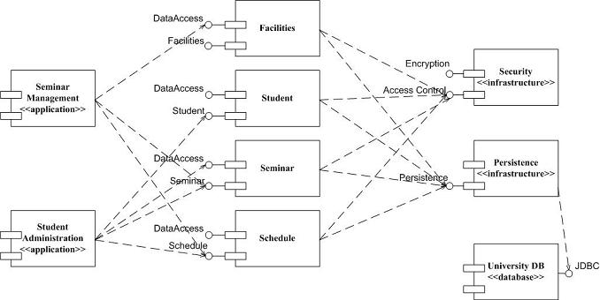
Component Diagram: UML 1.x and UML 2.0
(http://www.agilemodeling.com/artifacts/componentDiagram.htm)

Slide 28
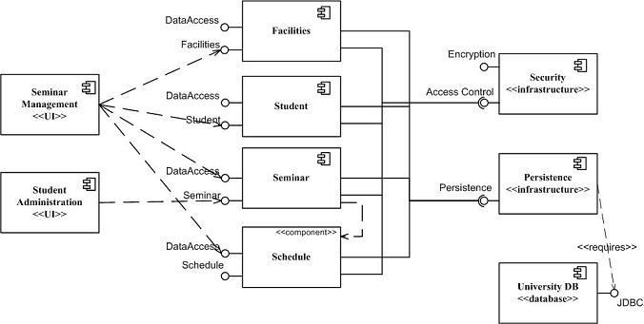
Component Diagram: UML 1.x and UML 2.0
(http://www.agilemodeling.com/artifacts/componentDiagram.htm)
So, how many different conventions for components in UML2.0?

Slide 29
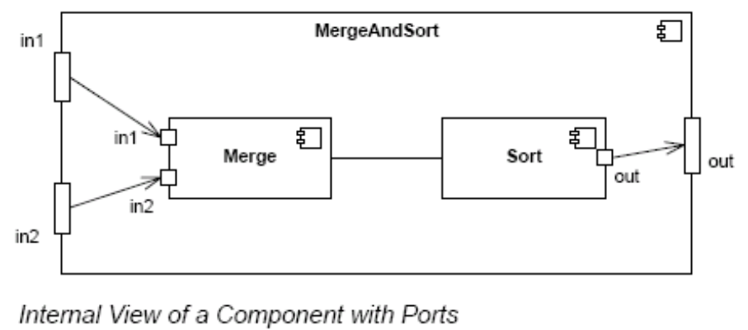
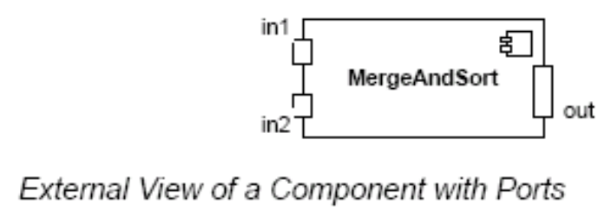
Component Diagram – Connector & Another Example
a connector: just a link between two or more connectable elements (e.g., ports or interfaces)
2 kinds of connectors: assembly and delegation. For “wiring”
  An assembly connector: a binding between a provided interface and a required interface (or ports) that indicates that one component provides the services required by another; simple line/ball-and-socket/lollipop-socket notation
  A delegation connector binds a component’s external behavior (as specified at a port) to an internal realization of that behavior by one of its parts (provide-provide, request-request).
delegation
delegation
assembly
connector
store
Left delegation: direction of arrowhead indicates
“provides”
So, what levels of abstractions for connections?
Right delegation: direction of arrowhead indicates
“requests”
Notes:
See UML text pg. 347 (figure 25-3) for an example.

Slide 30
Deployment Diagram
Shows a set of processing nodes and their relationships.
Represents the static deployment view of an architecture.
Nodes typically enclose one or more components.
TCP/IP
IIS + PhP Server
TCP/IP
J2EE Server
Membership Server
DecNet
Tomcat Server

Slide 31
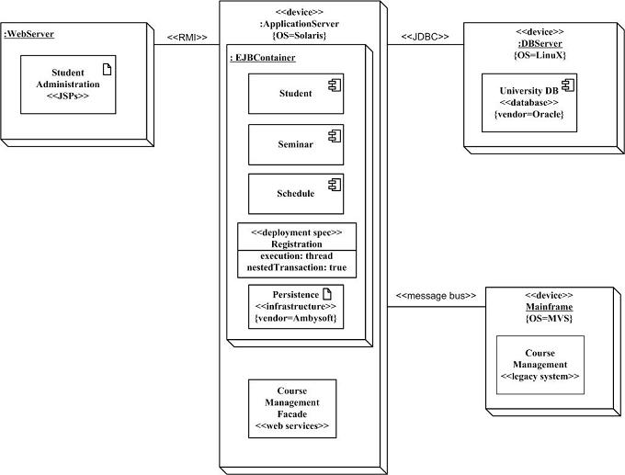
Structural Diagrams - Deployment Diagram
(http://www.agilemodeling.com/artifacts/deploymentDiagram.htm)
Student administration application
Physical nodes - stereotype device
WebServer - physical device or
software artifact
RMI/message bus: connection type
Nodes can contain other nodes
or software artifacts recursively
Deployment specs: configuration files:
name and properties

Slide 32
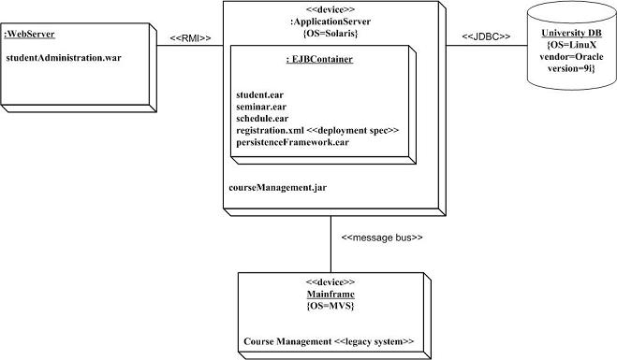
Structural Diagrams - Deployment Diagram
(http://www.agilemodeling.com/artifacts/deploymentDiagram.htm)
Is this better?
More concrete
Implementation-oriented

